Slide 1

DF
LECTURE
Law &
Computer Forensics
Diploma in CSF/IT
Year 2/3 (2022/23), Semester 4/6
Digital Forensics
7
Notes:
Left-hand Bar – Replace FSP by your module code and X by the lecture number.
Replace Lecture Title
Replace < Module Name >
Replace Year and Semester if necessary

Slide 2
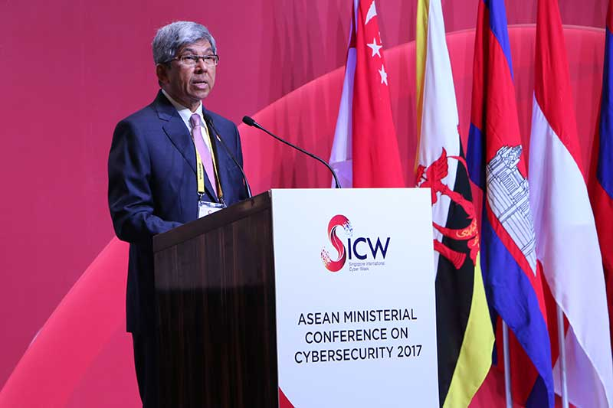
Objectives
At the end of this, you will get to know more about:
Computer Misuse Act and Cybersecurity Act for Cyber Crimes & Cybersecurity in Singapore

Slide 3

Law on Cyber/Computer Crimes in Singapore
The risks and threats in cyberspace are varied and laws are constantly evolving to tackle new threats.
Cyber/Computer crime was dealt with in Singapore’s Computer Misuse & Cybersecurity Act
Currently it’s called Computer Misuse Act (Cap 50A)
Primary tool for law enforcement officials in Singapore.

Slide 4
CMA Cap. 50A
Computer Misuse Act (CMA) was enacted in Singapore in 1993.
It was amended in 1 June 2017 as Computer Misuse and Cybersecurity (Amendment) Act (CMCA).
(currently Computer Misuse Act (Cap 50A)
In 2018, Cybersecurity Act was enacted
Reference:
Computer Misuse Act (CMA)
Computer Misuse and Cybersecurity (Amendment) Act 2017
Cybersecurity Act 2018
Notes:
Using hacked personal data a crime under proposed changes to cybercrime law Read more at https://www.channelnewsasia.com/news/singapore/using-hacked-personal-data-a-crime-under-proposed-changes-to-cyb-8773544

Slide 5
CMA Cap. 50A
The starting point for tackling cybercrimes is the Computer Misuse Act (“CMA”).
Covers unauthorised access, use or modification of computer, computer materials and computer services.
An offender can be charged for the chain of actions comprising his or her cybercrime.
CMA has extraterritorial reach – i.e. will apply even if an offence took place outside of Singapore or by a person residing outside Singapore. This is necessary given the borderless nature of cyber threats.

Slide 6
CMA Cap. 50A
The offences in Singapore’s CMA, Cap. 50A, are as follows:
Unauthorised access to computer material.
Access with intent to commit or facilitate commission of offence.
Unauthorised modification of computer material.
Unauthorised use or interception of computer service.
Unauthorised obstruction of use of computer.
Unauthorised disclosure of access code.
8A: Supplying, etc., personal information obtained in contravention of certain provisions
8B: Obtaining, etc., items for use in certain offences
Enhanced punishment for offences involving protected computers.
Abetments and attempts punishable as offences.
Notes:
Unauthorised access to computer material 3. —(1) Subject to subsection (2), any person who knowingly causes a computer to perform any function for the purpose of securing access without authority to any program or data held in any computer shall be guilty of an offence and shall be liable on conviction to a fine not exceeding $5,000 or to imprisonment for a term not exceeding 2 years or to both and, in the case of a second or subsequent conviction, to a fine not exceeding $10,000 or to imprisonment for a term not exceeding 3 years or to both. [21/98]
(2) If any damage is caused as a result of an offence under this section, a person convicted of the offence shall be liable to a fine not exceeding $50,000 or to imprisonment for a term not exceeding 7 years or to both. [21/98]
(3) For the purposes of this section, it is immaterial that the act in question is not directed at —
(a) any particular program or data;
(b) a program or data of any kind; or
(c) a program or data held in any particular computer.
[UK CMA 1990, s. 1]
Access with intent to commit or facilitate commission of offence 4. —(1) Any person who causes a computer to perform any function for the purpose of securing access to any program or data held in any computer with intent to commit an offence to which this section applies shall be guilty of an offence. [21/98]
(2) This section shall apply to an offence involving property, fraud, dishonesty or which causes bodily harm and which is punishable on conviction with imprisonment for a term of not less than 2 years. [21/98]
(3) Any person guilty of an offence under this section shall be liable on conviction to a fine not exceeding $50,000 or to imprisonment for a term not exceeding 10 years or to both. [21/98]
(4) For the purposes of this section, it is immaterial whether —
(a) the access referred to in subsection (1) is authorised or unauthorised;
(b) the offence to which this section applies is committed at the same time when the access is secured or at any other time. [21/98]
[UK CMA 1990, s. 2]
Unauthorised modification of computer material 5. —(1) Subject to subsection (2), any person who does any act which he knows will cause an unauthorised modification of the contents of any computer shall be guilty of an offence and shall be liable on conviction to a fine not exceeding $10,000 or to imprisonment for a term not exceeding 3 years or to both and, in the case of a second or subsequent conviction, to a fine not exceeding $20,000 or to imprisonment for a term not exceeding 5 years or to both. [21/98]
(2) If any damage is caused as a result of an offence under this section, a person convicted of the offence shall be liable to a fine not exceeding $50,000 or to imprisonment for a term not exceeding 7 years or to both. [21/98]
(3) For the purposes of this section, it is immaterial that the act in question is not directed at —
(a) any particular program or data;
(b) a program or data of any kind; or
(c) a program or data held in any particular computer.
(4) For the purposes of this section, it is immaterial whether an unauthorised modification is, or is intended to be, permanent or merely temporary.
[UK CMA 1990, s. 3]
Unauthorised use or interception of computer service 6. —(1) Subject to subsection (2), any person who knowingly —
(a) secures access without authority to any computer for the purpose of obtaining, directly or indirectly, any computer service;
(b) intercepts or causes to be intercepted without authority, directly or indirectly, any function of a computer by means of an electro-magnetic, acoustic, mechanical or other device; or
(c) uses or causes to be used, directly or indirectly, the computer or any other device for the purpose of committing an offence under paragraph (a) or (b),
shall be guilty of an offence and shall be liable on conviction to a fine not exceeding $10,000 or to imprisonment for a term not exceeding 3 years or to both and, in the case of a second or subsequent conviction, to a fine not exceeding $20,000 or to imprisonment for a term not exceeding 5 years or to both. [21/98]
(2) If any damage is caused as a result of an offence under this section, a person convicted of the offence shall be liable to a fine not exceeding $50,000 or to imprisonment for a term not exceeding 7 years or to both. [21/98]
(3) For the purposes of this section, it is immaterial that the unauthorised access or interception is not directed at —
(a) any particular program or data;
(b) a program or data of any kind; or
(c) a program or data held in any particular computer.
[Canada CLAA 1985, s. 301.2 (1)]
Unauthorised obstruction of use of computer 7. —(1) Any person who, knowingly and without authority or lawful excuse —
(a) interferes with, or interrupts or obstructs the lawful use of, a computer; or
(b) impedes or prevents access to, or impairs the usefulness or effectiveness of, any program or data stored in a computer,
shall be guilty of an offence and shall be liable on conviction to a fine not exceeding $10,000 or to imprisonment for a term not exceeding 3 years or to both and, in the case of a second or subsequent conviction, to a fine not exceeding $20,000 or to imprisonment for a term not exceeding 5 years or to both. [21/98]
(2) If any damage is caused as a result of an offence under this section, a person convicted of the offence shall be liable to a fine not exceeding $50,000 or to imprisonment for a term not exceeding 7 years or to both. [21/98]
Unauthorised disclosure of access code 8. —(1) Any person who, knowingly and without authority, discloses any password, access code or any other means of gaining access to any program or data held in any computer shall be guilty of an offence if he did so —
(a) for any wrongful gain;
(b) for any unlawful purpose; or
(c) knowing that it is likely to cause wrongful loss to any person. [21/98]
(2) Any person guilty of an offence under subsection (1) shall be liable on conviction to a fine not exceeding $10,000 or to imprisonment for a term not exceeding 3 years or to both and, in the case of a second or subsequent conviction, to a fine not exceeding $20,000 or to imprisonment for a term not exceeding 5 years or to both. [21/98]
Enhanced punishment for offences involving protected computers 9. —(1) Where access to any protected computer is obtained in the course of the commission of an offence under section 3, 5, 6 or 7, the person convicted of such an offence shall, in lieu of the punishment prescribed in those sections, be liable to a fine not exceeding $100,000 or to imprisonment for a term not exceeding 20 years or to both. [21/98]
(2) For the purposes of subsection (1), a computer shall be treated as a “protected computer” if the person committing the offence knew, or ought reasonably to have known, that the computer or program or data is used directly in connection with or necessary for —
(a) the security, defence or international relations of Singapore;
(b) the existence or identity of a confidential source of information relating to the enforcement of a criminal law;
(c) the provision of services directly related to communications infrastructure, banking and financial services, public utilities, public transportation or public key infrastructure; or
(d) the protection of public safety including systems related to essential emergency services such as police, civil defence and medical services. [21/98]
(3) For the purposes of any prosecution under this section, it shall be presumed, until the contrary is proved, that the accused has the requisite knowledge referred to in subsection (2) if there is, in respect of the computer, program or data, an electronic or other warning exhibited to the accused stating that unauthorised access to that computer, program or data attracts an enhanced penalty under this section. [21/98]
Abetments and attempts punishable as offences 10. —(1) Any person who abets the commission of or who attempts to commit or does any act preparatory to or in furtherance of the commission of any offence under this Act shall be guilty of that offence and shall be liable on conviction to the punishment provided for the offence.
(2) For an offence to be committed under this section, it is immaterial where the act in question took place.

Slide 7
Penalties of Cyber/Computer Crime in Singapore
Most of the provisions (except one) of the CMA carry a maximum fine up to S$10,000 and/or imprisonment up to 3 years for a 1st offense.
For the 2nd and subsequent offenses, the penalty is a fine up to S$20,000 and/or imprisonment up to 5 years.
If there was damage caused as a result of the crime, the penalty is a fine up to $50,000 and/or imprisonment up to 7 years.

Slide 8

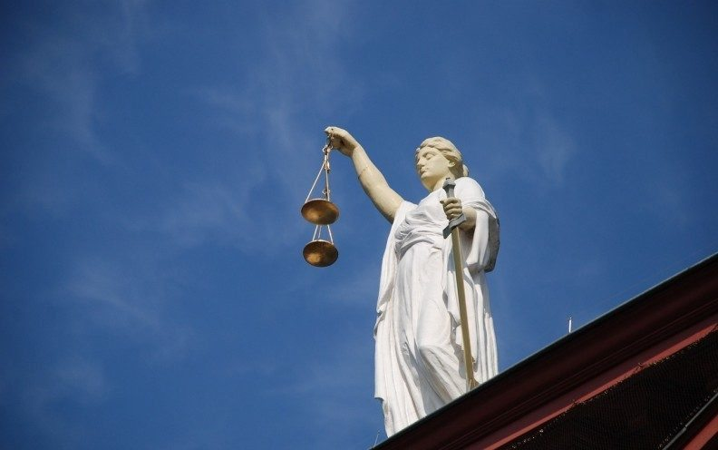
Penalties of Cyber/Computer Crime in Singapore – cont.
If the crime involved a threat to Singapore’s security, or to the banking or other financial, communications, or transportation industries, or to public services including utilities, safety, police, civil defence, or medicine, the penalty is a fine up to S$100,000 and/or imprisonment up to 20 years.
Notes:
Changes to Singapore's cybercrime law passed
Under the amended Computer Misuse and Cybersecurity Act, dealing in personal information obtained via a cybercrime such as trading in hacked credit card details is deemed illegal, as is dealing in hacking tools to commit a computer offence.
Changes to the existing Computer Misuse and Cybersecurity Act (CMCA) were passed in Parliament on Monday (Apr 3), amid observations from members that businesses here need to pay heed to the amendments.
Under the amended Act, dealing in personal information obtained via a cybercrime such as trading in hacked credit card details is deemed illegal, as is dealing in hacking tools to commit a computer offence.
It is also now an offence for someone committing a criminal act while overseas, against a computer located overseas, should the act "cause or create a significant risk of serious harm in Singapore". The Ministry of Home Affairs define serious harm as injury or death or disruptions to essential services.
http://www.channelnewsasia.com/news/singapore/changes-to-singapore-s-cybercrime-law-passed-8712368

Slide 9
3. Unauthorised access to computer material
Any person who knowingly causes a computer to perform any function for the purpose of securing access without authority to any program or data held in any computer shall be guilty of an offence.
[UK CMA 1990, s. 1]

Slide 10
4. Access with intent to commit or facilitate commission of offence
Any person who causes a computer to perform any function for the purpose of securing access to any program or data held in any computer with intent to commit an offence to which this section applies shall be guilty of an offence.
This applies to an offence involving property, fraud, dishonesty or which causes bodily harm.
[UK CMA 1990, s. 2]

Slide 11
5. Unauthorised modification of computer material
Any person who does any act which he knows will cause an unauthorised modification of the contents of any computer shall be guilty of an offence.
[UK CMA 1990, s. 3]

Slide 12
6. Unauthorised use or interception of computer service
Any person who knowingly :
secures access without authority to any computer for the purpose of obtaining, directly or indirectly, any computer service;
intercepts or causes to be intercepted without authority, directly or indirectly, any function of a computer by means of an electro-magnetic, acoustic, mechanical or other device; or
uses or causes to be used, directly or indirectly, the computer or any other device for the purpose of committing an offence under paragraph a) or b),
shall be guilty of an offence.
[Canada CLAA 1985, s. 301.2 (1)]

Slide 13
7. Unauthorised obstruction of use of computer
Any person who, knowingly and without authority or lawful excuse :
interferes with, or interrupts or obstructs the lawful use of, a computer; or
impedes or prevents access to, or impairs the usefulness or effectiveness of, any program or data stored in a computer,
shall be guilty of an offence.

Slide 14
8. Unauthorised disclosure of access code
Any person who, knowingly and without authority, discloses any password, access code or any other means of gaining access to any program or data held in any computer shall be guilty of an offence if he did so:
for any wrongful gain;
for any unlawful purpose; or
knowing that it is likely to cause wrongful loss to any person.
shall be guilty of an offence.

Slide 15
8A. Supplying, etc., personal information obtained in contravention of certain provisions
(1) A person shall be guilty of an offence if the person, knowing or having reason to believe that any personal information about another person (being an individual) was obtained by an act done in contravention of section 3, 4, 5 or 6 —
obtains or retains the personal information; or
supplies, offers to supply, transmits or makes available, by any means the personal information

Slide 16
8B. Obtaining, etc., items for use in certain offences
(1) A person shall be guilty of an offence if the person
obtains or retains any item to which this section applies —
intending to use it to commit, or facilitate the commission of, an offence under section 3, 4, 5, 6 or 7; or
with a view to it being supplied or made available, by any means for use in committing, or in facilitating the commission of, any of those offences; or
makes, supplies, offers to supply or makes available, by any means any item to which this section applies, intending it to be used to commit, or facilitate the commission of, an offence under section 3, 4, 5, 6 or 7.

Slide 17
8B. Obtaining, etc., items for use in certain offences
(2) This section applies to the following items:
any device, including a computer program, that is designed or adapted primarily, or is capable of being used, for the purpose of committing an offence under section 3, 4, 5, 6 or 7;
a password, an access code, or similar data by which the whole or any part of a computer is capable of being accessed.

Slide 18
9. Enhanced punishment for offences involving protected computers
Where access to any protected computer is obtained in the course of the commission of an offence under section 3, 5, 6 or 7, the person convicted of such an offence shall, in lieu of the punishment prescribed in those sections, be liable to a fine not exceeding $100,000 or to imprisonment for a term not exceeding 20 years or to both.

Slide 19
9. Enhanced punishment for offences involving protected computers – cont.
For the purposes of above subsection, a computer shall be treated as a “protected computer” if the person committing the offence knew, or ought reasonably to have known, that the computer or program or data is used directly in connection with or necessary for:
the security, defence or international relations of Singapore;
the existence or identity of a confidential source of information relating to the enforcement of a criminal law;

Slide 20
9. Enhanced punishment for offences involving protected computers – cont.
the provision of services directly related to communications infrastructure, banking and financial services, public utilities, public transportation or public key infrastructure; or
the protection of public safety including systems related to essential emergency services such as police, civil defence and medical services.

Slide 21
10. Abetments and attempts punishable as offences
Any person who abets the commission of or who attempts to commit or does any act preparatory to or in furtherance of the commission of any offence under this Act shall be guilty of that offence and shall be liable on conviction to the punishment provided for the offence.
For an offence to be committed under this section, it is immaterial where the act in question took place.

Slide 22
Cybersecurity Act 2018
The Act establishes a legal framework for the oversight and maintenance of national cybersecurity in Singapore.
Aim to enhance Singapore’s cyber security landscape and strengthen the city state's ability to routinely protect the nation’s critical information infrastructure (CII).
Creates a regulatory framework for the monitoring and reporting of cybersecurity threats to essential services in Singapore through the appointment of the Commissioner of Cybersecurity.
Also creates a licensing regime that will require certain data security service providers in Singapore to be registered.
https://sso.agc.gov.sg/Acts-Supp/9-2018/
https://www.csa.gov.sg/legislation/cybersecurity-act
Notes:
The Act applies to designated CII organisations that provide services to 11 critical sectors: Energy, Water, Banking & Finance, Healthcare, Transport (which includes Land, Maritime, and Aviation), Government, Info-communications, Media, and Security & Emergency Services.

Slide 23
NP IT Policies & Practices (Acceptable Use Policy)
1 GENERAL REQUIREMENTS (Last updated: Friday, 8 December 2017)
1.5
Users shall not abuse or misuse the IT Resources and shall take all reasonable measures to safeguard against any potential abuse, misuse, malicious attacks or theft. Abuse or misuse of the IT Resources includes, but not limited to, the doing of any act that would contravene the provisions of:
a. Copyright Act;
b. Computer Misuse Act;
c. Spam Control Act;
d. Films Act;
e. Penal Code;
f. Undesirable Publications Act;
g. Broadcasting & Television Act;
h. Indecent Advertisements Act;
i. Common Gaming Houses Act;
j. Maintenance of Religious Harmony Act;
k. Singapore Broadcasting Authority Act (in particular, Internet Code of Practice);
l. Official Secrets Act; and
m. Personal Data Protection Act.
http://www.np.edu.sg/cc/Intranet_Portal/Pages/intranet_itpolicies.aspx
Notes:
1 GENERAL REQUIREMENTS
1.1 Users¹ shall use the campus IT Resources³ according to the purpose for which they are provided, which is for the administrative, teaching and learning activities of NP. 1.2 Users shall familiarise themselves with the Polytechnic's IT Security Policies and Guidelines posted in the Intranet. 1.3 Users shall use the campus IT Resources according to the laws and regulations of the Singapore Government. 1.4 Staff and associates² shall comply with Government Instructions Manual (IM) and other regulations and guidelines when handling Government classified data or Personal Data. 1.5 Users shall not abuse or misuse the IT Resources and shall take all reasonable measures to safeguard against any potential abuse, misuse, malicious attacks or theft. Abuse or misuse of the IT Resources includes, but not limited to, the doing of any act that would contravene the provisions of:a. Copyright Act; b. Computer Misuse Act; c. Spam Control Act; d. Films Act; e. Penal Code; f. Undesirable Publications Act; g. Broadcasting & Television Act; h. Indecent Advertisements Act; i. Common Gaming Houses Act; j. Maintenance of Religious Harmony Act; k. Singapore Broadcasting Authority Act (in particular, Internet Code of Practice); l. Official Secrets Act; and m. Personal Data Protection Act. 1.6 Users shall not, under any circumstances and in any manner, transfer or copy any software, computer program, personal data, classified information or trade secret that is the subject of any copyright, special licence or other intellectual property right from NP Premises or IT Resources without NP’s prior written consent. 1.7 Users shall not use, modify or adapt corporate IT resources for any commercial purpose or personal financial gains, unless duly authorised by NP in writing. 1.8 Users shall not attempt to monitor another user’s data communications nor access, read, copy, change or delete another person’s files or software without authorisation. 1.9 Users shall not harass or intentionally deny or degrade another person’s legitimate access to IT resources. 1.10 User shall not circumvent any technological access control or protection measures which have been applied to a work or audio-visual item or a performance. Examples of circumvention are cracking of passwords, unscrambling of encrypted information or removal of digital watermarks. 1.11 Users shall not install and use diagnostic and/or vulnerability scanning tools on NP production systems and network under any circumstances, as such tools may be used to compromise the security of the systems. 1.12 Users shall not cause damage or otherwise attack or degrade the performance of NP network or systems. 1.13 Upon termination of employment (for staff), termination of contract (for associates) or cessation of study (for students), users shall promptly declare and return to NP all NP assets, software, files, manuals and material of whatever description and copies thereof, and any or all material which in the opinion of NP is of a secret or confidential nature relating to the Polytechnic's business or affairs which are in his possession or under his control.
2 DATA HANDLING
3 ACCOUNT IDs & PASSWORDS
4 PERSONAL COMPUTERS (PCs, NOTEBOOKS, PDAs or SMARTPHONES) AND ELECTRONIC STORAGE MEDIA
5 USE OF AUTHORISED SOFTWARE AND HARDWARE
6 EMAIL USAGE
7 INTERNET ACCESS, USAGE AND SOCIAL NETWORKING
8 NETWORK AND REMOTE ACCESS
9 INCIDENT REPORTING
10 RIGHTS OF THE POLYTECHNIC
11 FAILURE TO COMPLY
http://www.np.edu.sg/cc/Intranet_Portal/Pages/intranet_itpolicies.aspx

Slide 24
Summary
Offences in Computer Misuse Act:
Unauthorised access to computer material.
Access with intent to commit or facilitate commission of offence.
Unauthorised modification of computer material.
Unauthorised use or interception of computer service.
Unauthorised obstruction of use of computer.
Unauthorised disclosure of access code.
8A: Supplying, etc., personal information obtained in contravention of certain provisions
8B: Obtaining, etc., items for use in certain offences
Enhanced punishment for offences involving protected computers.
Abetments and attempts punishable as offences.

